Slide 1

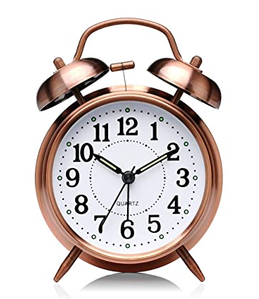
“ALARM CLOCK USING
PYTHON”
By
Rajiv Gurav (3027)
Akash Mane (3031)
Under the guidance of
Prof. Mr. Yogesh Lubal

Slide 2
Introduction :
This is not a wonder that an alarm clock has always been useful to warn us while we sleep, take a brief nap, or remind us about some important days that we might forget.
An alarm clock is a clock that is created in order to alert us at a specified time. The primary function of these clocks is to awaken people from their night's sleep or short naps; they are sometimes used for other reminders.
This is the simple GUI based method project which is developed using pythons package called Tkinter, time and pygame. The objective of our project is to implement an alarm clock using Python. Python consists of some very innovative libraries such as datetime and tkinter which help us to build the project using the current date and time

Slide 3
AbsTRACT :
This is a simple GUI based python project which includes basically make use of Tkinter,datetime,threading,pygame libraries.This project takes input as time and set alarm for that time. And when that time comes the music will play.

Slide 4
Problem Statement-
The problem is to design the alarm clock by using python.

Slide 5
Explanation:
Tkinter module belongs to a standard library of GUI in Python. It helps us to create a dialog box with any information that we want to provide or get from the users.Datetime and time modules in python help us to work with the dates and time of the current day when the user is operating python and to manipulate it too.Mixer module provides access to the basic sound playing machinery provided by Windows platforms. This is useful to generate the sound immediately when a function is called.

Slide 6

USES:-
To awaken people from their night's sleep or short naps
To schedule daily task .
Used for other reminders as well.

Slide 7
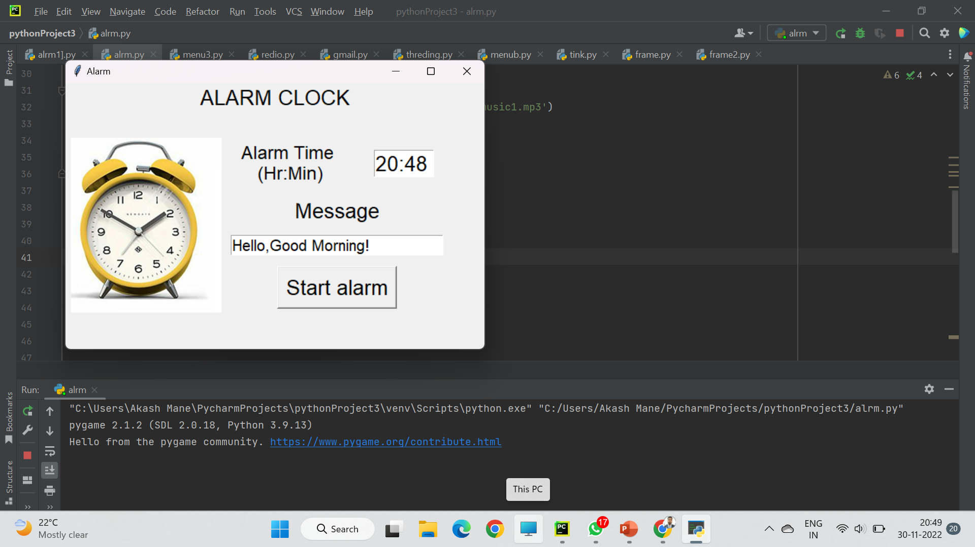
OUTPUT

Slide 8
CONCLUSION :-
The goal of this project, Alarm Clock Using Python, is to create an alarm clock using Python. Python contains some essential libraries such as DateTime and Tkinter, which assist us in constructing a project utilizing the current date and time. They also give a user interface to set the alarm according to the demand in a 24-hour format.

